Slide 1
The impact of walkable cities in Texas on the mental health of its residents
By: Malawika Gopinath, Raquel Luna, Richa Gandhi, and Bheshta Shahim

Slide 2
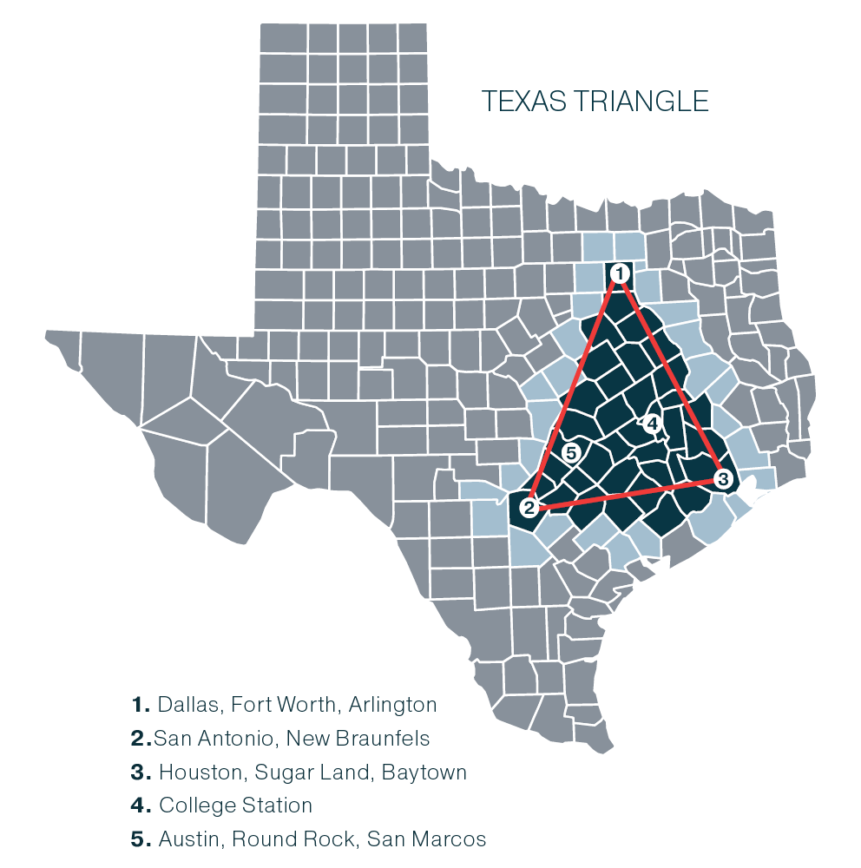
Area of Study
Metropolitan cities in Texas
Counties in DFW
Notes:
With this study, we aim to primarily focus on metropolitan areas in Texas and compare the walkability indexes of different major cities in the state. We also want to examine the counties within the Dallas-Fort Worth (DFW) area. As one of the largest and most rapidly growing metropolitan regions in the U.S., DFW provides a unique opportunity to investigate the relationship between walkability and health outcomes across diverse environments. We can analyze these patterns and trends to find correlations between walkability and the physical and mental health of residents. With these findings, we can provide insights into how urban design and infrastructure in Dallas and other cities can be optimized.

Slide 3

Research Question
Do walkable cities improve mental health?
Impact of urban walkability on mental health outcomes.
Focusing on depression and anxiety. (X)
Why is this important?
Preventative measure for mental health illness.
A future where city design can improve mental health.

Slide 4
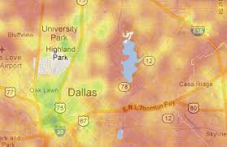
Methods: Heat maps
Utilize heat maps to measure walkability and its correlation with mental health outcomes
Looking specifically at DFW area to map walkability scores
Correlation identification: Identify regions with higher walkability scores and their relationship to depression and anxiety rates
Would be able to highlight potential hotspots for improved urban design that positively affects community mental health
Notes:
The first method we have chosen to evaluate are heat maps. This is because it can measure walkability index scores where its characterized by the ease of walkability. With our target of specifically looking at the DFW area to map the scores this allows for a correlation identification of seeing regions that have these higher scores. By looking at these scores we can see the relationship to rates of anxiety and depression. By doing this it can also highlight potential hotspots for improved urban design that can positively affect community mental health.

Slide 5

Methods
Variables
Walkability - National Walkability Index, NHGIS, Walk Score, etc.
Mental Health Outcomes - depression, anxiety, social isolation, quality of life, sense of community, etc.
Charts
Bar chart, dot plot
Heat map, choropleth map
Scatter plot
Data visualization concepts
Wilkinson - Statistical summarization; Geometric layers
Murrell - High-level plot functions
Ware - Encoding visual variables; Color theory and perception

